Slide 1

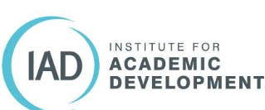

Co-creating a Manifesto for Interdisciplinary Learning and Teaching
Dr Jenny Scoles
Academic Developer, Institute for Academic Development
with Dr Maddie Winter and Ms Clare Cullen
Interdisciplinary Learning and Teaching Conference 2025

Slide 2
Principal’s Teaching Award Scheme:
“Crossing the Line”
David Overend (PI), Seongsook Choi, Andy Cross, Clare Cullen, David Jay, Jenny Scoles, and M. Winter.
Longitudinal, 4 year research project: Researching student and staff perceptions and experiences of what interdisciplinary teaching and learning ‘should’ look like, and how it is actually enacted in a classroom.
Creating a toolkit for educators to support interdisciplinary learning and teaching in schools, colleges and universities.
Writing an Interdisciplinary Learning and Teaching (IDTL) Strategy Manifesto

Slide 3

Manifestos as rhetorical practices of provocation
“Manifestos make new knowledge possible” (p.10)
“Good manifestos...do not claim to know things for all time; they only claim to know things for this moment. They trash and will be trashed”. (p.4)
Fahs, B. (2020). Burn it down!: Feminist manifestos for the revolution. Verso Books.
Stock image

Slide 4
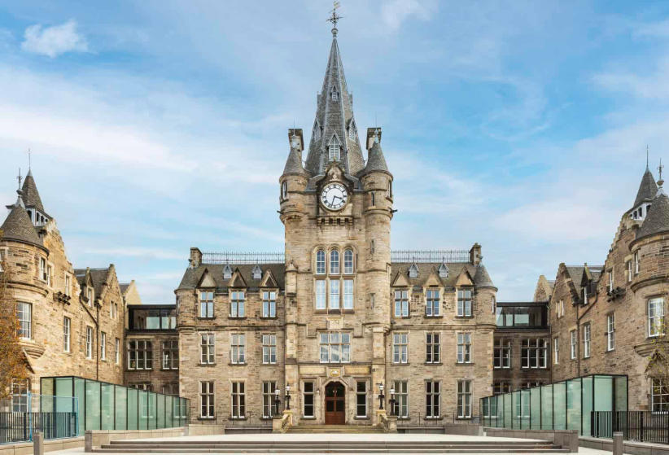
Edinburgh Futures Institute
“A new futures-focused space for learning, research, and innovation at the University of Edinburgh.”
MA (Hons) Interdisciplinary Futures- https://efi.ed.ac.uk/study/undergraduate/
“A new interdisciplinary programme, designed to develop key employability skills and collaborative experiences, focused on global and local challenges, and linked to cutting-edge research and the big future issues facing our planet and societies.”
36 UG students started Sept ’23

Slide 5
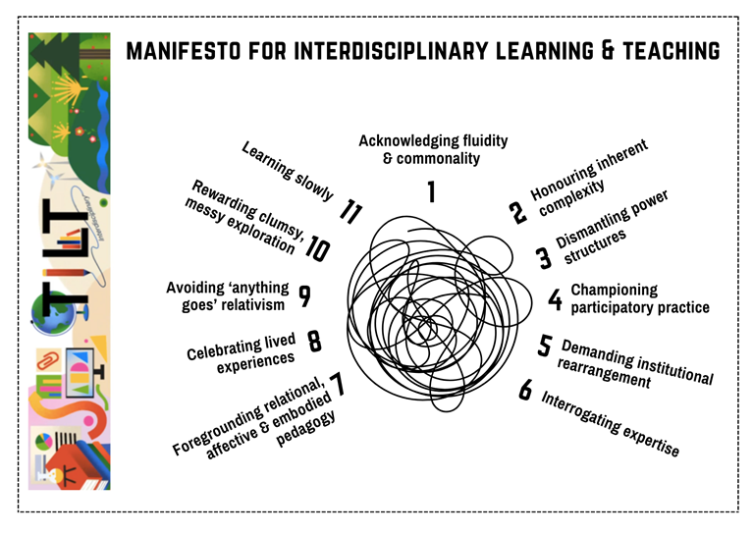
Methodology – Collaborative Autoethnography
“Autoethnography inherently value the researcher’s personal experience and subjectivity, and challenges traditional understandings of objectivity and neutrality in research.” (Noel et al, 2023, p.2)
Autoethnography combines autobiographical self-reflection and ethnographic investigation (Ellis et al., 2011).
Chang et al’s (2012) collaborative auto-ethnography approach - a participatory and democratic research methodology with emphasis on co-constructing narratives.
Collaboration in autoethnography allows for collective sense-making over shared experiences, which can account for multiple perspectives.
1. Research and teaching team - overlap between two but common denominator was a genuine passion and intellectual curiosity about IDTL in practice.
2. Two staff and two student focus groups; two staff and two student open-response questionnaires. We were active participants.
3. Drawing on own experiences of teacher-researcher-student in IDTL.
4. Deep dive into IDTL literature.
5. Key to this: iterative discussions internally and with external colleagues (organising guest speakers; Teams chats; coffees; pizza parties)

Slide 6
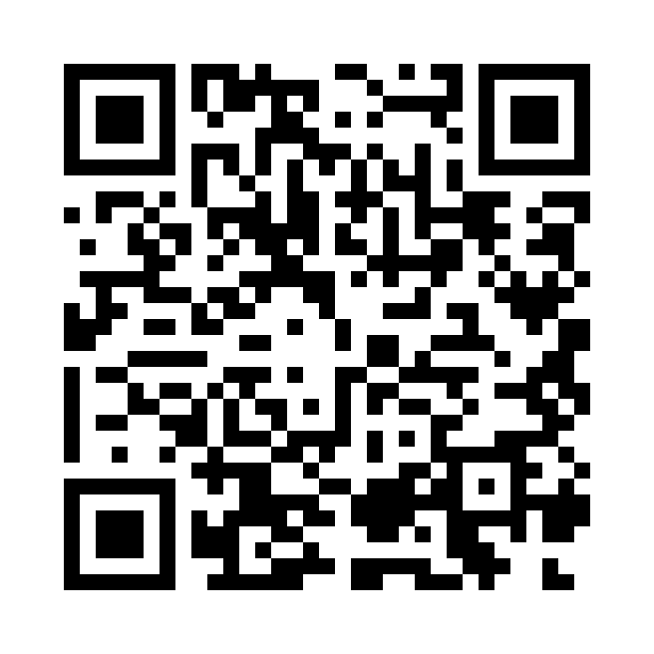
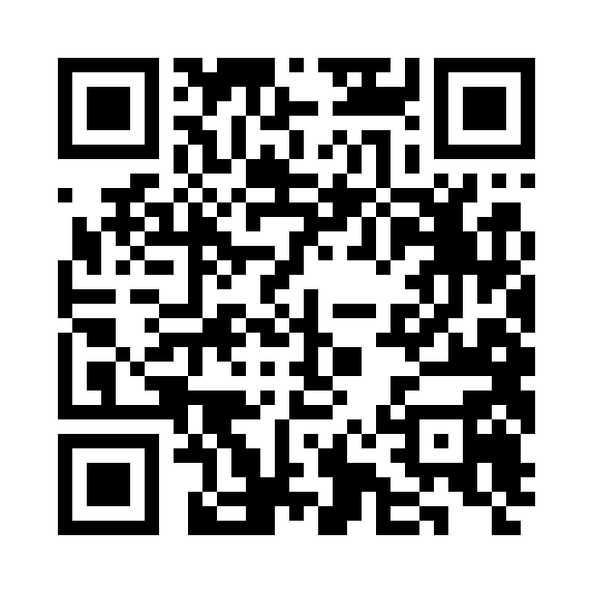
Tinkering, playing, refining, editing:
The process of co-constructing a narrative
Three of us from research team (Scoles, Cullen and Winter) wrote together in-person and online over one month to shape each principle.
First draft - met with the larger research team to critically assess each principle, conflating, rejecting and refining - each word had do as much work for us as possible .
Second draft - sent document to six critical friends with previous experience in IDLT and research; each gave comprehensive edits and comments to help challenge our thinking.
Third and final draft - involved much debate and discussion among the three of us to further refine and sharpen our thinking.
Final manifesto turned into PDF incorporated into Toolkit and animated into 5-minute video.
Manifesto video, by Simon Dures
Manifesto as PDF

Slide 7

IDLT Manifesto’s 11 Principles (abridged)
While interdisciplinarity cannot be singularly defined, general agreement can be achieved on its basic tenets.
In collectively exploring differing conceptualisations of interdisciplinarity, members within a learning community can deepen their understandings of how others view and practise interdisciplinarity, thereby nurturing commonality and empathy.
The world’s inherent complexity ought to be honoured in learning environments.
Whilst keeping things simple might be a useful starting point in learning, concealing the world’s messy liveliness with neat research methods, comfortable learning tasks and soothing conclusions only does a disservice to us all in the long run.
Pixabay, AI-generated, myshoun
Notes:
Likely agree that interdisciplinary teaching includes the gathering of multiple perspectives;
working within and through complexity a direct engagement with real world issues;
the need for shared reference points and understanding as a basis for action.
tending towards concrete answers and reductionist methods. As students are channelled towards disciplinary specialism, their learning can become limited to component parts and therefore separated from wider systems. Trying to conceal our world’s inherent messiness with neat research methods, we need a pioneering spirit to develop new, or different, research methods that can engage and contend with the messy liveliness of the world.

Slide 8

Power structures should be dismantled.
Interdisciplinary teaching and learning better equips people to challenge oppressive and unjust power structures, and, in turn, the challenging of these power structures enriches interdisciplinary teaching and learning.
Participatory practice is vital for interdisciplinary learning.
In co-creating and sustaining new shared spaces and cultures within and beyond the learning environment, we can promote accessibility, champion diversity and nurture democratic communities.
Pixabay CC0
Notes:
colonialism, capitalism, globalism, environmental destruction, and anthropocentricism determine the distribution of power within the classroom.
IDTL better equips people to challenge these power structures and that the challenging of power structures enriches interdisciplinary teaching and learning.
Interdisciplinary educators and students must not only reveal and dismantle oppressive power structures within their wider communities, but also co-create truly inclusive, hopeful and equitable futures.
Involves learning through doing, together, so will often draw on models of experiential learning. participatory practice is more than inclusion and exclusion; it is being aware of who has the power to invite others into existing teaching and learning spaces.

Slide 9

Existing academic institutional structures inhibit interdisciplinary teaching.
Honest and critical interrogating of present physical, organisational and social structures is paramount if programme and course design are to embrace diverse ways of thinking and the interconnectedness of all learning.
The notion of expertise should be interrogated.
Knowledge arises not from the teacher alone, but through co-creative and interactive processes between more than one individual. Understanding that a learner’s lived experience extends beyond their identity as a student allows the whole self to be valued.
Pixabay, tanrica
Notes:
organisation of timetables and term schedules), to the perceptual (such as the perceived ownership and authority over different territories of knowledge, disciplines and expertise) and social (relationships with colleagues, external partners and students).
Bringing in lived curriculum - When we actively invite students to bring their whole self – emotions, body, spirit as much as mind – into the learning experience, we can start to expand the notion of expertise to permit democratic conversation, exchange and co-creation. This necessitates that we all, irrespective of our experience, approach learning with humility and an open mind. Such a reconfiguration places educators not just as ‘teachers’ but also mentors, learners, facilitators, troublers, and co-conspirators. Humble inquiry

Slide 10

Relational, affective and embodied pedagogy in the interdisciplinary classroom is an ethical imperative.
Thinking and learning do not only happen in the brain. Inviting students to engage with their bodies, emotions and relationships creates space for their diverse ways of experiencing, thinking and learning about themselves and the world.
Students’ lived experiences and awareness of one’s own worldview can be more important than their disciplinary background.
When interdisciplinary educators move beyond simply asking students “What discipline did, or do, you study?”, and instead question “How do you view and come to know the world?”, they permit the diverse types of knowledge, lived experiences, and ways of knowing that are needed to engage with our complex world.
Pixabay, bookdragon
Notes:
our body's relationship with the environment and with other people (relational). our emotions (affective) and the way we use our bodies (embodied) also play a huge part in what and how we learn. Here, trust and creating a safe space is vital to respect. Questions will naturally arise about how much of oneself you reveal to others before a line is perhaps crossed. ?This demands vulnerability and trust from both students and educators that one’s whole self will be respected because . Aligning teaching and assessment strategies with these values will engender true equity and inclusion in the interdisciplinary classroom.

Slide 11

Be wary of ‘anything goes’ relativism
This can happen if the provenance and purpose of information go uninterrogated. Students and educators must work together to create learning environments where freedom of speech is respected and the capacity to engage with evidence, and in respectful and critically informed debate, is actively nurtured.
Teaching should make space for clumsy and messy exploration
Rather than seeking a single, elegant solution to a proposed problem, we should value experimentation, tinkering, self-directed learning and learning from failure. These approaches will foster lifelong curiosity and a love of learning that transcends formal education.
Notes:
curriculum, we also argue that any important interdisciplinary endeavour must employ the discerning use of evidence and data to underpin learning and teaching; its absence would be ethically harmful. As such, expansive learning and teaching practices are not equivalent to ‘anything goes.’ We believe that teaching critical thinking skills and academic rigour is vital; . Mis/disinformation poses real threats, and the denial of climate change or poverty is ethically dangerous. Students and educators must work together to create learning environments where freedom of speech is respected and the capacity to engage in debate is actively nurtured. This should be done without compromising others’ dignity and humanity.
Rather than seeking a single, elegant solution to a proposed problem, interdisciplinary teaching should embrace the clumsy, exploratory process that unfolds along the way.

Slide 12

Learning will be, at times, uncomfortable and necessarily slow.
Educators must create safe and supportive spaces in which students can take intellectual risks and navigate interdisciplinarity’s non-linear learning journey.
https://blogs.ed.ac.uk/teaching-matters/an-interdisciplinary-learning-and-teaching-manifesto/
OpenClipArt-vectors, Pixabay
Notes:
. This can make students feel uncomfortable with, and even unsure of, interdisciplinary teaching methods. It may take time for students to appreciate the benefits of this way of learning. This process will not be easy or linear; it will be uncomfoIn creating a safe space in which to take intellectual risks, educators can support students to sit with and navigate their way through any discomfort.rtable and necessarily slow.

Slide 13
Manifesto as a learning activity
Course activity: asking learners to decide which statements they agree with, which they are opposed to, and which they would rewrite. Helps groups decide what is important to them as they embark on an interdisciplinary learning journey. Return to at the end of a course or project, to see if the statements need to change.
Teaching Matters blog post: a student's critique of the 11 points of the manifesto through their personal experiences in an interdisciplinary classroom.
PTAS project - Centre for Open Learning: “using workshops to explore the challenges and opportunities of interdisciplinary thinking, working, learning and teaching using key prompts in the TILT manifesto… to create specific online guidance resources and exemplars for teaching staff who wish to develop interdisciplinary lifelong learning courses.” (Macleod, Hermiston & Scoles, 2025)

Slide 14
References
Chang, H., Ngunjiri, F., & Hernandez, K. A. (2013). Collaborative autoethnography. Left Coast Press.
Ellis, C., Adams, T. E., & Bochner, A. P. (2011). Autoethnography: An overview. Forum for Qualitative Social Research, 12(1).
Fahs, B. (2020). Burn it down!: Feminist manifestos for the revolution. Verso Books.
McLeod, D., Hermiston, S., & Scoles, J. (2025). Cultivating ‘Citizen Scholars’: Developing approaches to interdisciplinary open access lifelong learning and teaching within higher education. Principal’s Teaching Award Scheme Application, The University of Edinburgh.
Noel, T.K, Minematsu, A., & Bosca, N. (2023). Collective Autoethnography as a Transformative Narrative Methodology. International Journal of Qualitative Methods, 22.

